Slide 1
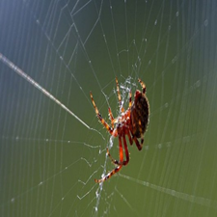
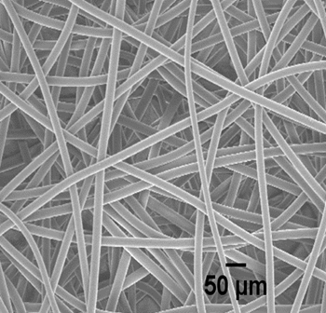
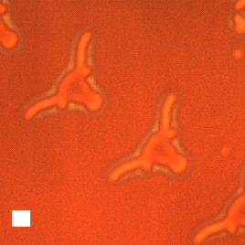
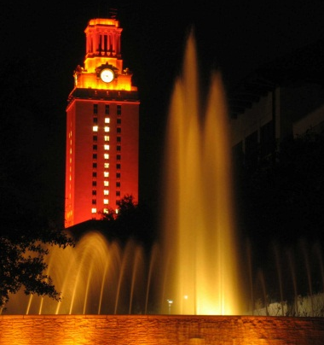
Manipulating Polymers with Light Activated Chemistries for Patterning Films and Manufacturing Fibers
Christopher J. Ellison
McKetta Department of Chemical Engineering
and Texas Materials Institute
The University of Texas at Austin
ellison@che.utexas.edu
Notes:
1

Slide 2
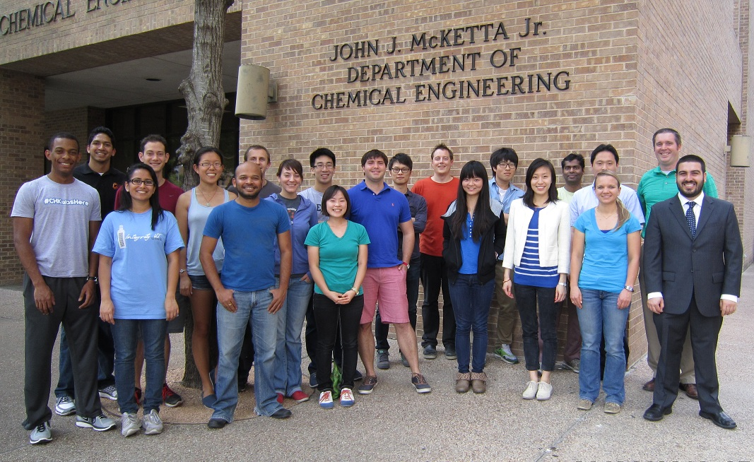







Acknowledgements
Welch Foundation (F-1709)
NSF CAREER (DMR-1053293)
ACS PRF 49881-DNI7
3M Nontenured Faculty Award
DuPont Young Professor Award

Slide 3
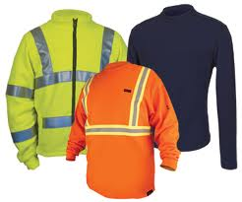
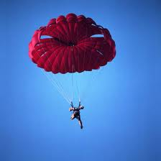
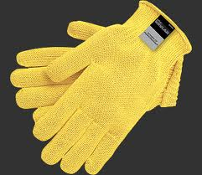
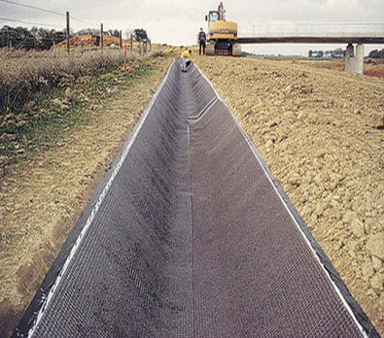
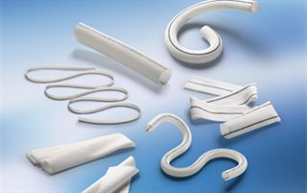
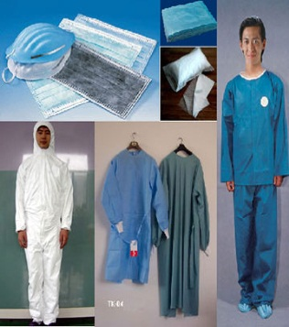
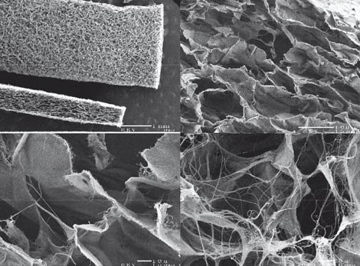
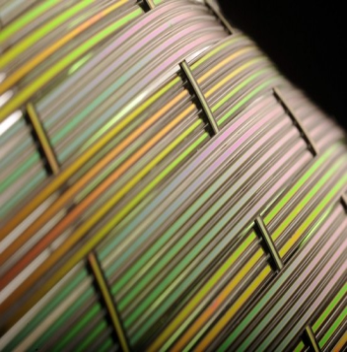

Fibers: From Clothing to Advanced Materials
Clothing
Technical textiles
Synthetic grafts, surgical aids, tissue engineering scaffolds
Piezoelectric fibers
Plastic optical fibers
http://inventors.about.com/od/pstartinventions/ss/Parachute_7.htm
http://www.nationalfirefighter.com/index.php?cPath=6
http://www.mcrsafety.com/index.php/gloves/products/kevlar_gloves
http://www.archiexpo.com/prod/afitex/nonwoven-geotextiles-for-drainage-1588-306972.html
http://articles.textileclass.com/medical-textiles-manufacturers-companies-who-produce-medical-fabrics/
http://www.medicaldevice-network.com/features/feature731/feature731-1.html
http://www.engadget.com/2010/07/13/mits-piezoelectric-fibers-can-act-as-speaker-or-microphone-don/
http://www.danbru.com/blog/?blog=plastic-optical-fiber-comeback

Slide 4
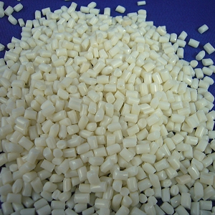
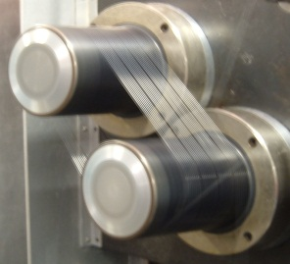
Current Polymer Fiber Manufacturing
Conventional (> 10 microns)
Melt extrusion / spinning
Solution spinning
Advanced (10 nm to 10 microns)
Electrospinning (electric fields)
Melt blowing (hot air jets)
Forcespinning™ (centrifugal forces)
Processing preformed polymers (long chain molecules) into fibers.
Substantial use of solvent or heat: a necessity to lower viscosity for processing.
Solvents or heat
+ processing
Solvent recovery/recycling or thermal energy input
Critical sustainability challenges
Bulk polymer
Fibers
Can we make fibers without any solvent or heat??
http://www.fiber-science.com/fswp002.htm
http://www.globaltextiles.com/manufacturers
Notes:
Restricting to polymer derived fibers
Whether it is conventional fiber manufacturing used to make microfibers or advanced fiber manufacturing methods used to make nanofibers
Unifying theme is use of organic volatile solvents or heat input is a necessity in fiber manufacturing.
This is because

Slide 5

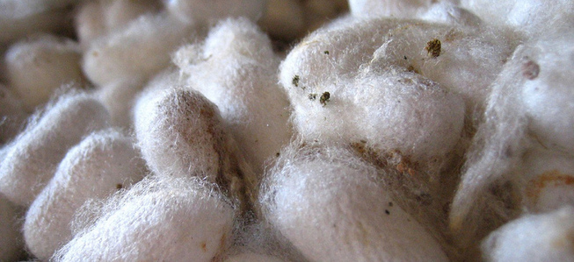
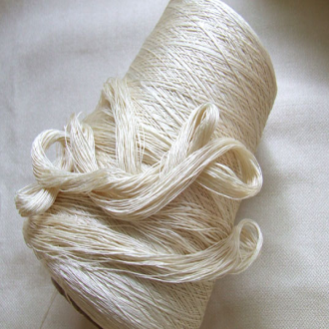
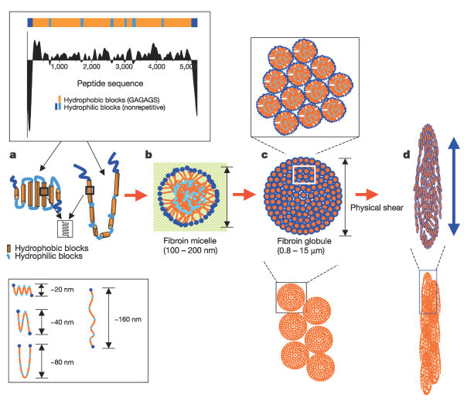
Nature’s Approach
Mechanically strong and tough fibers
Made in a benign way
Spiders and Silkworms
Intricate self-assembly of protein constituents during the fiber formation process
The science of spider silk formation is evolving
A sophisticated biochemistry to understand and mimic
Hyoung-Joon Jin and David L. Kaplan, Nature, 2003, 424, 1057-1061
Notes:
Can we make fibers without any solvent or heat ?? Nature has the answer.
Looking at silk fiber production by spiders and silkworms
Have a benign way of making mechanically strong and tough fibers through an intricate self-assembly of protein constituents during the fiber formation process
Obtaining a complete and fundamental understanding of this biosynthetic process, or engineering synthetic silk fibers with equivalent mechanical properties, is an open challenge in the field.

Slide 6
Bio-inspired Approach
Start with small molecules and build long chain structures in real time
Concept of simultaneous polymerization and extrusion
Spiders silk spinning rate : 1-10 cm/s∗
Synthetic fiber extrusion speeds (melt blowing, etc.) : > 1 m/s
Need extremely fast and robust polymerization chemistry
Chemistry of Thiol-ene Photopolymerization
Fast kinetics under ambient conditions (room T in air)
Only requires addition of a light source to existing fiber equipment
∗K. B. Guess, C. Viney, Thermochim. Acta 1998, 315, 61.
Notes:
Viewed broadly, nature’s approach of chemically linking small functional units into long chain molecules and solid fibrillar structures while simultaneously extruding the fibers is fundamentally different from current synthetic fiber manufacturing methods, where extrusion of pre-formed long chain polymers is facilitated with organic solvent or heat.
Can we broadly adapt nature‘s approach to make fibers without solvents or heat
The main challenge is to find chemistries by which one can rapidly mediate interactions between the functional units within the time scale of extrusion.

Slide 7
Simultaneous Reaction and Extrusion
Other uses:
Nanoimprinting
Dental restorative materials
Extracellular matrix mimics
Hydrogels for protein delivery
Gas transport membranes
Desireable attributes:
Fast polymerization rates in air
Can be low shrinkage at high conversion
Network homogeneity
Wide choice of thiol and -ene monomers
Thiol-ene Photopolymerization:
A Step-growth Polymerization Under Some Circumstances
Hoyle et al., J. Polym. Sci. Pol. Chem. 2004, 42, 5301.Hagberg et al., Nano Lett. 2007, Lu et al., Dent. Mater. 2005, 21, 1129. Fairbanks et al., Adv. Mater. 2009, 21, 5005,Aimetti et al., Biomaterials 2009, 30, 6048, Kwisnek et al., Macromolecules 2009, 42, 7031.
Notes:
Under some circumstances thiol-ene photopolymerization proceeds in a step growth

Slide 8
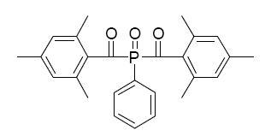
Thiol-ene Fiber Process: Solventless and Heatless
200 W metal halide w/LLG and collimating lens, ~200 mW/cm²
1.02 mm ID needle
Dipentaerythritol Pentaacrylate (DPPA)
Grounded collector
Syringe pump
High voltage supply
Irgacure 2100
Pentaerythritol tetrakis (3-mercaptopropionate) (PETT)
monomers
Onset of photocuring
Solid photo-cured fibres
Challenges:
Matching curing kinetics with high velocity of spinning
Available curing time < 0.5 secs
Notes:
Our approach was to conduct in-situ photopolymerization of thiol and ene monomers during fiber spinning.
We used a multifunctional acrylate and thiol compound.
It is important to note these have very low vapor pressure. Boiling points above 300 C or so.
Integrating thiol-ene photopolymerization and electrospinning into a simultaneous process presents several operational challenges. The curing kinetics must be matched to the speed of the high velocity fluid jet moving towards the collector.
Reported (Reneker et al.) jet velocity is ~0.5 m/s. We have estimated our average jet velocity at the collector as ~1 m/s, based on known feed rates and typical starting and final fiber diameters. Considering this speed and the distance between the needle tip and-collector, the available time for photopolymerizing the thiol-ene fluid jet in-situ is ~0.1 s.
Choosing mulitfunctional monomers for faster kinetics

Slide 9
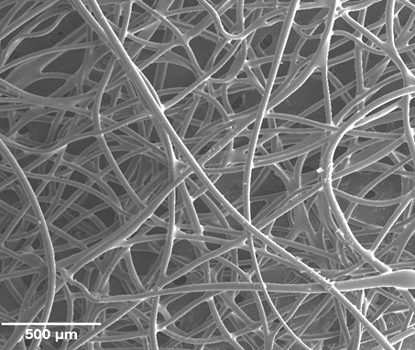
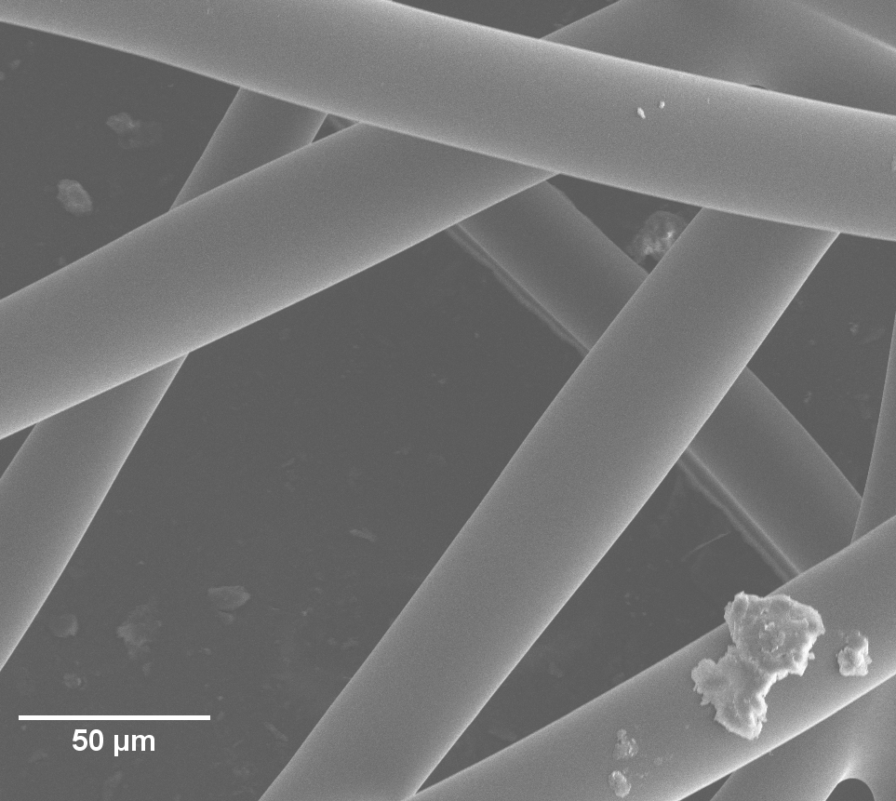
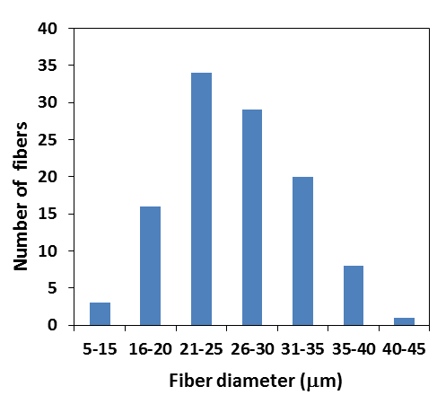
First Generation of Thiol-ene Fibers
Pentaerythritol tetrakis (3-mercaptopropionate) (PETT) and dipentaerythritol pentaacrylate (DPPA) in 1:4.4 thiol to ene ratio along with 6wt% Irgacure 2100TM as photoinitiator.
Solid continuous fibers reproducibly obtained at 1:4.4 ratio of thiol to ene groups in spinning mixture
Molar ratio of thiol:ene groups critical
Influences both curing kinetics and viscosity of spinning fluid
C.J. Ellison and K. Shanmuganathan, Patent application (PCT/US12/32465) filed .
K. Shanmuganathan, R. Sankhagowit, P.Iyer and C.J. Ellison, Chem. Mater., 2011, 23 (21), 4726–4732
Notes:
Low and high magnification SEM images of thiolene fibers made by photopolymerization of pentaerythritol tetrakis (3-mercaptopropionate) and dipentaerythritol pentaacrylate in a 1:4.4 thiol to ene ratio along with 6wt% Irgacure 2100 as photoinitiator.

Slide 10
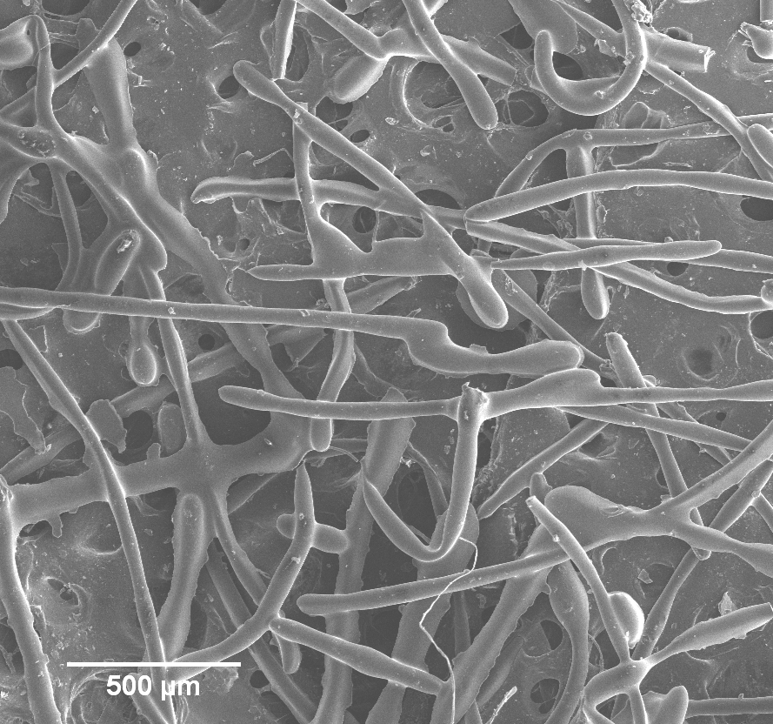
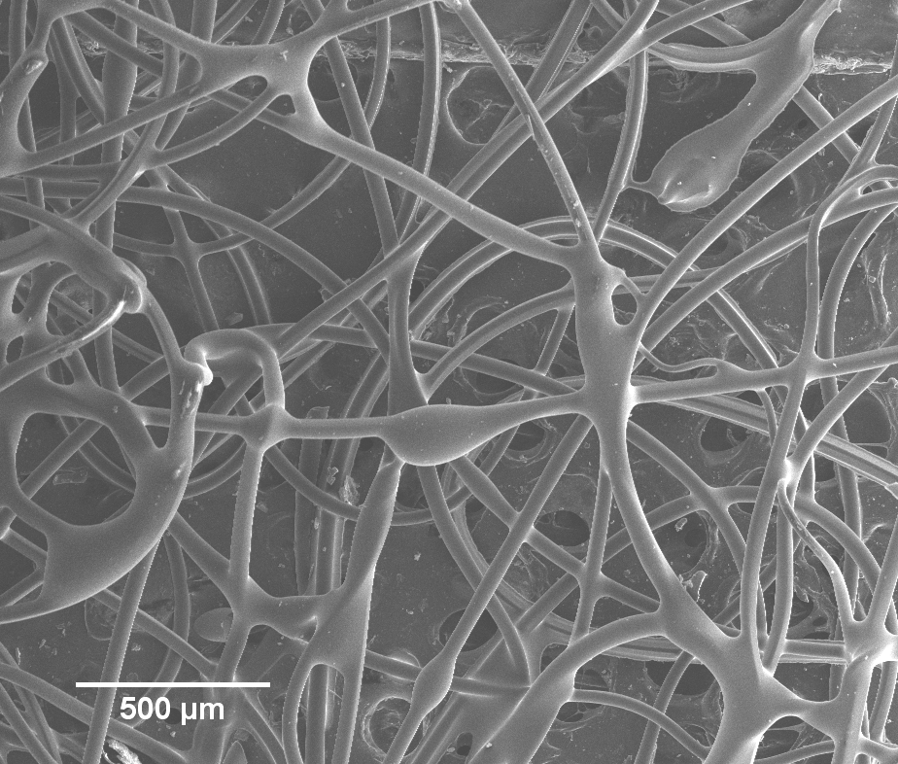
Importance of Thiol to Ene Ratio
More thiol
Less thiol
.
1:3.4 ratio of thiol to ene
Discontinuous and partially cured fibers
1:5.6 ratio of thiol to ene
Continuous but partially cured fibers
Fiber quality: A delicate balance of photocuring kinetics and viscoelastic properties of the spinning mixture
C.J. Ellison and K. Shanmuganathan, Patent application (PCT/US12/32465) filed .
K. Shanmuganathan, R. Sankhagowit, P.Iyer and C.J. Ellison, Chem. Mater., 2011, 23 (21), 4726–4732
Notes:
When the stoichiometry of thiol to ene is slightly altered, we observed quite significant changes in fiber morphology, such as partially cured discontinuous strands and other defects
SEM images of thiolene fibers made by photopolymerization of pentaerythritol tetrakis (3-mercaptopropionate) (PETT) and dipentaerythritol pentaacrylate (DPPA ) (a) in a 1:3.4 thiol to ene ratio and (b) in a 1:5.6 thiol to ene ratio along with 6wt% Irgacure 2100 as photoinitiator
a simultaneous interplay of several physical and chemical factors including fluid viscoelasticity, surface tension, electrostatic forces, and curing kinetics. For example, electrostatic repulsive forces tend to increase the surface area of the electrified jet originating from the needle tip, while surface tension can induce the elongated jet to break into spheres to minimize surface area; high viscosities can limit rapid diameter reduction while low viscosities facilitate it.

Slide 11
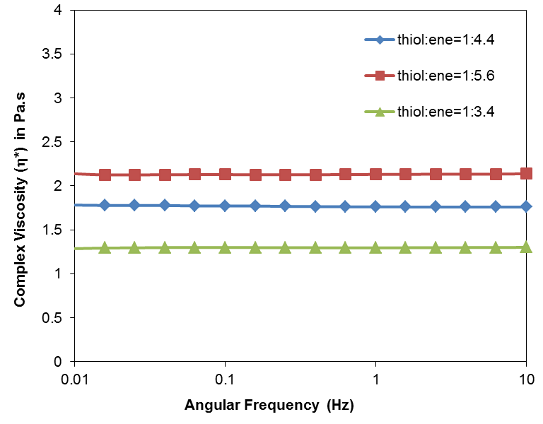
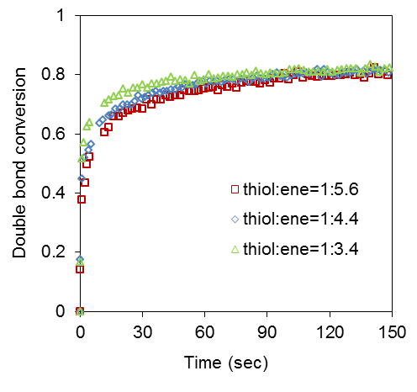
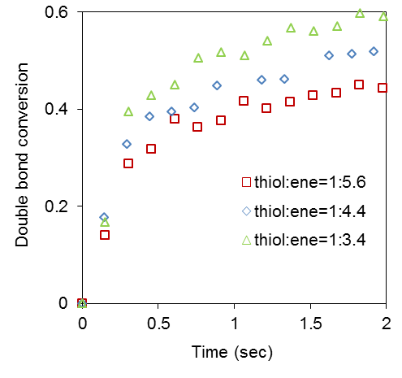


Viscosity and Curing Kinetics
Increasing Thiol
Viscosity too low
Cure kinetics too slow
1:4.4 ratio of thiol to ene provides fast kinetics in short time scales with a suitable viscosity
C.J. Ellison and K. Shanmuganathan, Patent application (PCT/US12/32465) filed .
K. Shanmuganathan, R. Sankhagowit, P.Iyer and C.J. Ellison, Chem. Mater., 2011, 23 (21), 4726–4732
Notes:
Fig (right) shows the photocuring kinetics of the different mixtures of thiol-ene described above. Though the final conversion of ene groups and the kinetics are roughly similar at first glance there is a significant difference at very short curing times, i.e., less than 2 seconds (right bottom). In this timescale, the mixture with a thiol to ene ratio of 1:4.4 cures faster compared to 1:3.4 or 1:5.6. Since the time available for curing the thiol-ene filament en route to the collector is fractions of a second, slight kinetic differences in this regime likely have significant impact on fiber quality.
Also the thiol monomer used here is less viscous than the ene monomer. The viscosity of the thiol-ene mixture with 1:4.4 ratio of thiol to ene groups that yielded high quality fibers is about 1.7 Pa-s. A lesser thiol to ene ratio (1:5.6) increases the viscosity to 2.1 Pa-s, while increasing the thiol content (1:3.4) decreases the viscosity to 1.3 Pa-s.
With more thiol (previous slide), viscosity of mixture is less. Hence surface tension forces dominate.
With less thiol, viscosity is sufficient to resist deformation but curing becomes slower.
Reducing the thiol content below a certain level can also reduce photocuring rates in air, and ultimately adversely affect final fiber quality. In traditional acrylate photopolymerizations, oxygen reacts with carbon radicals to form a peroxy radical. Peroxy radicals are less reactive than carbon radicals and therefore oxygen quenches the reaction. In a thiol-ene photopolymerization, the peroxy radical abstracts hydrogen from a thiol unit regenerating thiyl radicals making thiol-ene polymerizations less sensitive to oxygen. This feature is instrumental in performing this fiber forming process in ambient conditions and it could be an important controlling factor in fiber quality in some circumstances.

Slide 12
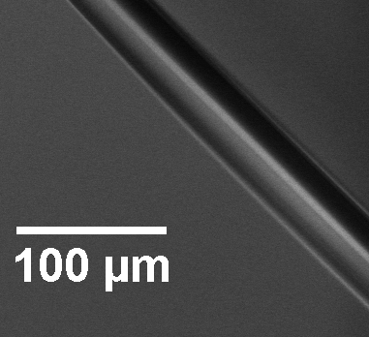
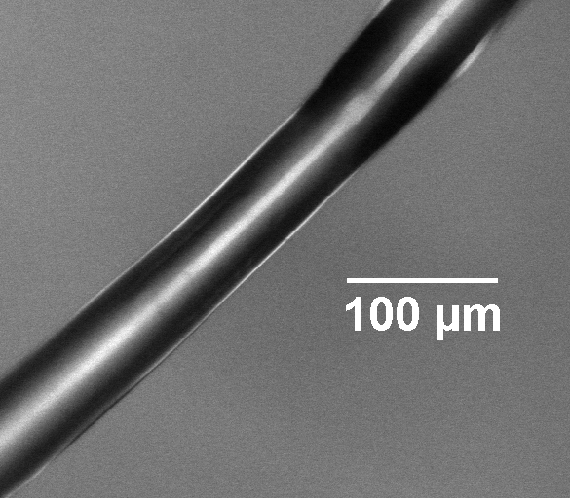
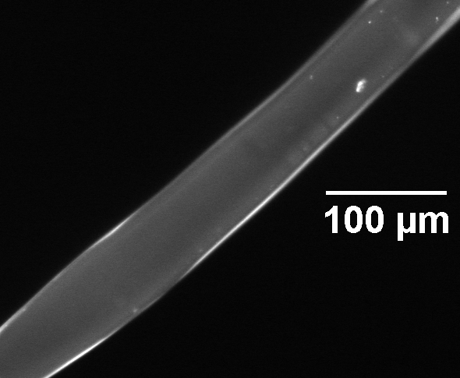
Reactive Surfaces: Multifunctional Materials
Thiolene fibers before treatment with fluorescent marker
Dipentaerythritol Pentaacrylate (DPPA)
Bright field
Fluorescence
Thiolene fibers after reaction with fluorescent marker
Pentaerythritol tetrakis (3-mercaptopropionate) (PETT)
Bright field
Fluorescence
Josh Katzenstein
Notes:
We are using a multifunctional monomers here. Some unreacted thiol and double bonds will exist in the photopolymerized fibers. We can monitor the conversion of both the thiol and double bonds using IR spectroscopy.
Fibers have about 40-50% unreacted thiol and double bonds
Attaching flourescent markers to fibers

Slide 13
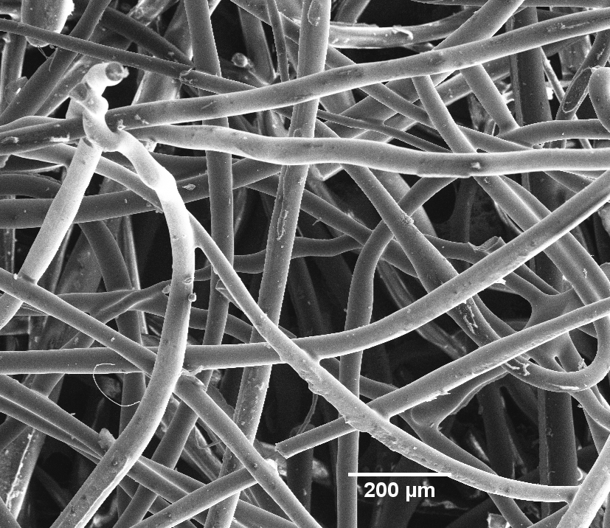
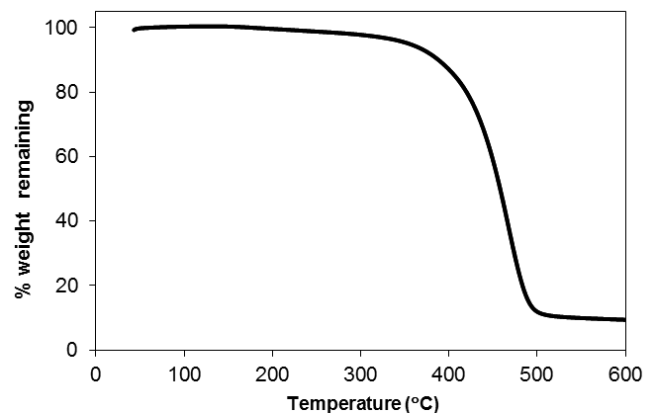
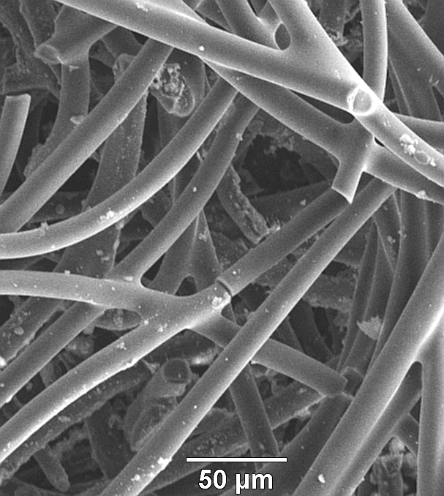
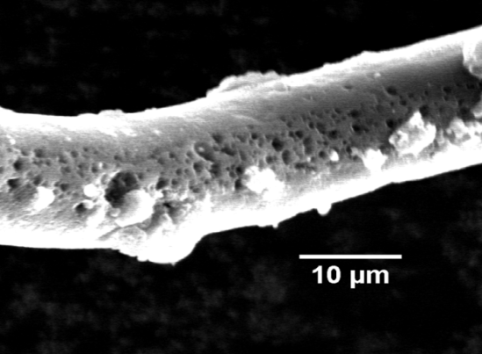
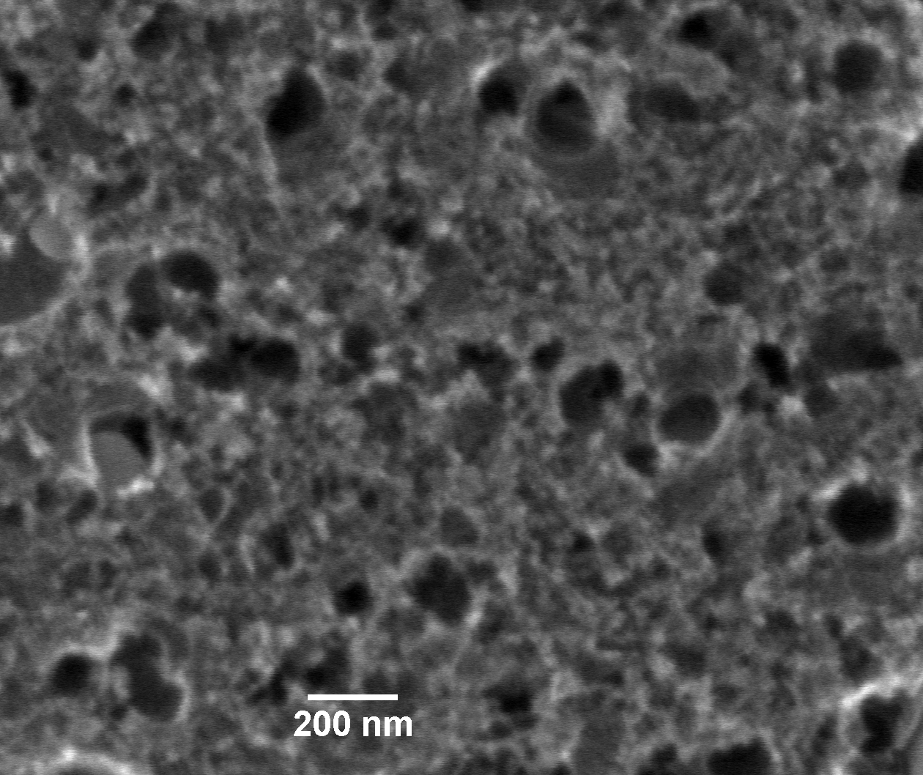
Chemical and Thermal Stability
Thiol-ene fibers not soluble or fractured by swelling in THF or immersing in toluene at 50 °C for 4 h
Negligible weight loss until above 350 °C in inert atmosphere
Mesoporous Carbon Fibers
Fibers retain shape after heating up to 1000 °C in nitrogen
Mesoporous structure:
10-200 nm pore size
Notes:
What’s more interesting is that the fibers retain shape even after heating to 1000C
These fibers show a mesoporous structure with pore size between 10-200 nm.

Slide 14
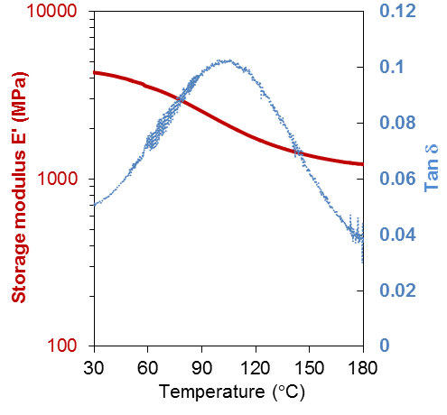
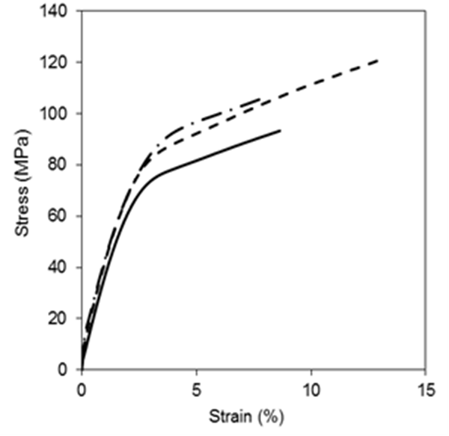
Thermomechanical Stability of Thiol-ene Fibers
Spider silk fibers from different spiders
E‘ > 4 GPa at 50 °C
> 1 GPa at 180 °C
Stress-strain behavior of 3 fibers
Vollrath F and Knight DP, Nature, 2001, 410, 541-548
8-12 % strain at break
C.J. Ellison and K. Shanmuganathan, Patent application (PCT/US12/32465) filed .
K. Shanmuganathan, R. Sankhagowit, P.Iyer and C.J. Ellison, Chem. Mater., 2011, 23 (21), 4726–4732
    High thermomechanical stability
    (~10 GPa 25ºC, > 3 GPa 200ºC)
Notes:
The fiber formation reported here relies on externally triggering covalent interactions between functional segments.
This has several significant advantages. The fibers have very good chemical stability because of the crosslinked molecular architecture formed during curing.
For example, thiol-ene fibers were not soluble or fractured by swelling in THF or toluene, which are good solvents for the ene and thiol precursors.
Further, the morphology of the fibers was unaffected even after immersing the fibers in toluene at 50 °C for 4 hrs.
The fibers have very good thermal stability upto 400C indicating their crosslinked network architecture

Slide 15
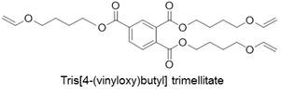
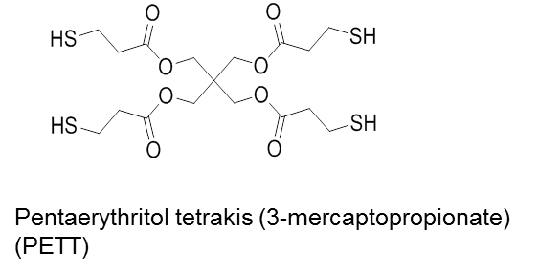
Stretchable Elastic Fibers and Nonwoven Mats
Fiber mechanical properties can be tuned by choice of chemistry
Irgacure 2100

Slide 16
Stretchable Elastic Fibers and Nonwoven Mats
Single fibers show good strength and ~ 40% elongation at break
Mechanical properties of nonwoven mat at ~90% porosity at room T
Mechanical properties show little degradation after strain cycling nonwoven mat to 40% strain
Nonwoven mats are robust at 200°C.

Slide 17
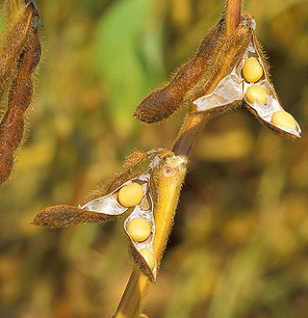
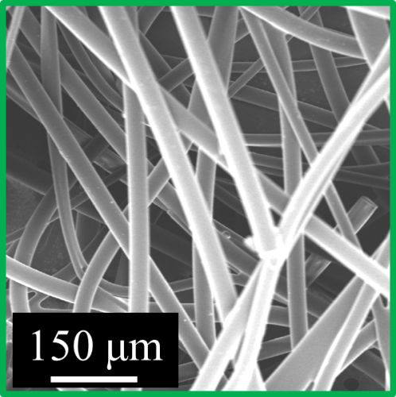
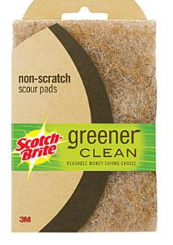

Petroleum vs. Biorenewable Feedstocks
Worldwide Production of Nonwoven Fibers*
  > 1 × 10⁹ kg/year
  > 1 × 10¹⁰ $/year
  Biorenewable Polymers
    Poly(lactide) (PLA)
    Poly(trimethylene terepthalate)
USDA
Acrylated Epoxidized Soybean Oil (AESO)
Inks/Coatings
(Webster Group, NDSU)
Sheet Molding Compound Resins (Wool Group, U. Del.)
Thermoset Foams (K.-Y. Lee et al. Green Chemistry, 2011)
*Lee and Cassill, Journal of Textile and Apparel, Technology and Management (2006)
© 3M 2012. All Rights Reserved.

Slide 18
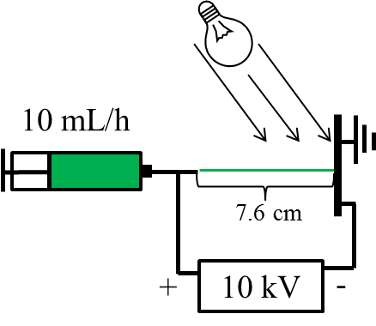
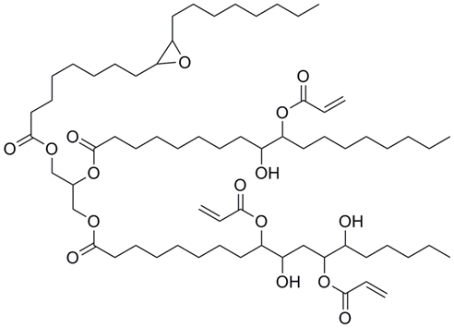

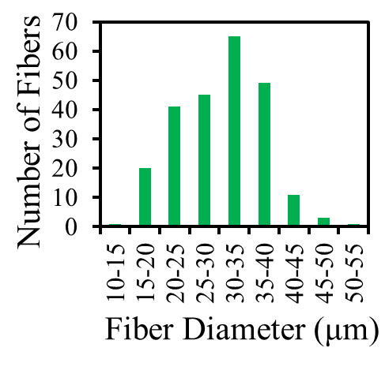
Soybean Oil Based Fibers
51 wt. % AESO
29 wt. % DPPA
M_{n} = 1138 g/mol, f = 2.7
Dipentaerythritol Pentaacrylate
M_{n} = 525 g/mol, f = 5
14 wt. % PETT
6 wt. % Irgacure 2100
Fibers
Pentaerythritol tetrakis(3-mercaptopropionate)
M_{n} = 489 g/mol, f = 4
C.J. Ellison et al, US Patent application filed .
D.W.Janes, K. Shanmuganathan, D.Y. Chou and C.J. Ellison, ACS Macro Letters, 2012, 1, 1138−1142.

Slide 19
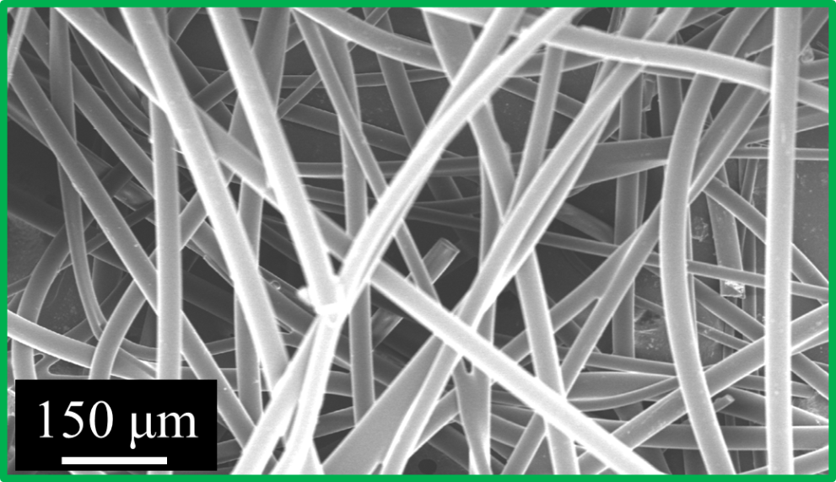
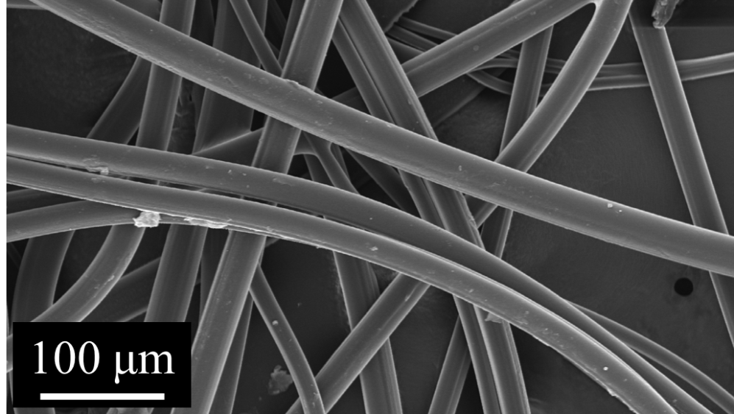
Soybean Oil Fibers – Thermochemical Stability
2 º/min in N₂
Soak in 80 ºC Toluene for 5 h
Dry in vacuo

Slide 20
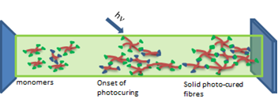

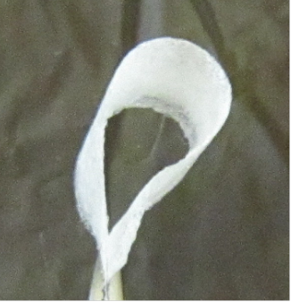
Fiber Summary
A simple route to fiber manufacturing based on photopolymerization chemistry, which eliminates the need for using toxic solvents or heat energy.
    Insensitive to oxygen / can be conducted at room temperature in air
    Thermally (up to 400 ºC) and chemically (hot toluene, etc.) stable fibers due to cross-linking
    High modulus over wide temperature range (~4 GPa 25ºC, > 1 GPa 180ºC)
    Multifunctionality can be exploited, many thiols and enes remaining
    Adaptable to all continuous spinning methods
    Nanofibers coming soon!
C.J. Ellison and K. Shanmuganathan, Patent application (PCT/US12/32465) filed .
K. Shanmuganathan, R. Sankhagowit, P.Iyer and C.J. Ellison, Chem. Mater., 2011, 23 (21), 4726–4732.
C.J. Ellison et al, US Patent application filed (soybean oil)
D.W.Janes, K. Shanmuganathan, D.Y. Chou and C.J. Ellison, ACS Macro Letters, 2012, 1, 1138−1142.

Slide 21
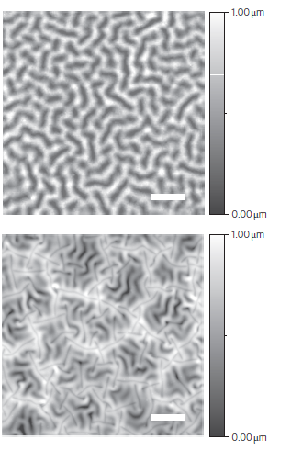


Micropatterning in Polymer Films - Applications
Anti-Biofouling
Neurite Guiding
Photovoltaic Devices
Wrinkles
Folds
http://www.sharklet.com
Rajnicek, A. M.; Britland, S.; McCaig, C. D.
J. Cell Sci. 1997, 110, 2905-2913.
Kim, JB, et al.,
Nat. Photonics 2012, 6, 327-332.
Notes:
Notes:
Neurite Guidance: The basic idea is that neurites preferentially align down grooves, in these images groves are 1 um wide and 320 nm deep (not too far out of our realm). They are made of quartz, but could imagine using our stuff to pattern these materials.
Photovoltaic devices: Top is wrinkles with 1.8 um period and peak to valley height of 180 nm. It is then compressed and the fractional area of the folds is 0.174. Under compression some of the wrinkles collapse by ‘self-contact’. Basically in the sharp line area stress has made the wrinkles stick together. (scale bar is 5 um)

Slide 22



Micropatterning in Polymer Films - Methods
LISA/LISC
EHP
Polymers
Polymerizable Liquids
Dickey, M.; et al.
J. Mater. Sci. 2008, 43, 117-122.
Chou, S. Y.; Zhuang, L.
J. Vac. Sci. Technol. B 1999, 17, 3197-3202
Schaffer, E.; et al.
Nature 2000, 403, 874-877
Notes:
LISA is image of PMMA, the top is the mask and the bottom is the transferred image. 530 nm pillar height, 1.6 um pillar diameter. Their model has localized positive charge formed by electrohydrodynamic instabilities rising toward the top plate. 130 °C for “5-80 mins” under vacuum. They say it doesn’t depend on heating time…though I’m not sure that makes sense.
EHP of polymers is a ‘brominated PS film (h=45 nm). Features are ~125 nm deep. Aspect ratio 0.83. Took 14 hours at 170 °C.
Polymerizable liquid is a thiol-ene reaction that started as a spin cast film of 800 nm.

Slide 23




The Marangoni Effect
‘Tears’ of Wine
Thin Film Striations
Photo credits:
http://www.flickriver.com/photos/selago/3388356089/
http://athome.harvard.edu/programs/stone/imageframe/37.html
http://www.coatings.rutgers.edu/Defects.htm

Slide 24



Topography Formation – Polystyrene (PS) Films
After 1 min. Light Exposure – Metal Halide Lamp
After 10 min. Heating
Light = Exposed
Dark = Unexposed
10 minute heating at 110 °C without mask
M_{n} = 2900 g/mol, PDI = 1.2
T_{g} = 61 °C by DSC

Slide 25

Photochemical Dehydrogenation of PS
UV light → backbone dehydrogenation
Formation of ‘stilbene-like’ units
Red shifted fluorescence compared to PS
  Solutions in THF
  ~0.05 mg/mL
Excitation wavelength = 310 nm
hν
Fluorescence (a.u.)
Blue = Neat PS
Red = Exposed PS
Wavelength (nm)

Slide 26
Photochemical Dehydrogenation of PS
Conversion of PS to partially-dehydrogenated analog (diamonds) increases with UV exposure dose
  Measured by FTIR
  Filled point represents typical dose and conversion: 1 minute exposure
Surface chemistry changes qualitatively measured by water contact angle (squares)
Conversion (%)
Contact Angle (°)
Dose (J/cm²)*
hν
*Note: Dose is measured as intensity of entire output spectrum
of lamp including wavelengths PS does not absorb.
Notes:
FTIR: Disappearance of methylene in backbone, normalized by carbonyl in initiator fragment (ATRP – EBIB)

Slide 27
The Marangoni Number
$Ma=−\frac{Γ^{′}H^{2}∇C_{PS}}{μD}$
  $Γ^{′}$ = Surface energy change with composition
  H = Characteristic length (half pitch)
  C_{PS} = Concentration of PS
  $μ$ = Viscosity
  $D$ = Diffusion coefficient
Critical value for instabilities = 80¹
  Critical conversion: 0.02%
  Actual conversion: 6.4%
Ma in this system ~ 20000
  Orders of magnitude above critical value
Critical Conversion
1) Reichenbach, J.; Linde, H. J. Colloid Interface Sci. 1981, 84, 433-443.

Slide 28
Other Photochemical Effects?
XPS:
No Oxidation
SEC:
No Chain Coupling Events
O 1s
Unexposed = Dashed
Exposed = Solid
Unexposed = •
Exposed = ■

Slide 29

Pattern Diversity - Direct Pattern Transfers
Patterns directly from photomasks
Profilometery trace follows dark line
Features go either direction
  Up = Exposed
  Down = Protected
Scale bars = 30 μm

Slide 30




Pattern Diversity - Multiple Exposures
Same Mask Rotated 90° 2nd Exp.
Different Masks
Large Bumps
‘Dogbones’
Multiple line-and-space mask exposures
Development step after all exposures completed
Small Bumps
‘Lines-in-Lines’
Notes:
Large Bumps: 12.5 μm chrome lines on a 25 μm pitch
Small bumps: 5 μm chrome lines on a 10 μm pitch
Two on right:
First exposure: 12.5 μm chrome lines on a 25 μm pitch photomask
Second exposure: 5 μm lines on a 10 μm pitch photomask

Slide 31


Topographic Feature Formation
Lines
Arbitrary Shapes
Notes:
Ticker in corner is real time at development temperature.

Slide 32
Model of Marangoni Flow Process
$\frac{∂h}{∂t}=−\frac{Γ_{0}}{3μ}\frac{∂}{∂x}\left(h^{3}\frac{∂^{3}h}{∂x^{3}}\right)−\frac{1}{2μ}\frac{∂}{∂x}(h^{2}\frac{∂Γ}{∂x}$)
Transient Film Height
Visco-Capillary
Forcing
Marangoni Forcing
Terms:
  h = Film Height
  𝛤₀ = Mean Surface Energy
  μ = Viscosity
  h₀ = Initial Film Thickness
Introduced a surface energy that varies in position and time
With Roger Bonnecaze

Slide 33


Summary and Future Directions
Marangoni-driven flow is a powerful technique for patterning polymer films
  Directed topography formation driven by surface energy gradients from patterned photochemistry
Versatile and potentially high throughput method
Continuing to study mechanism
  Modeling
  Kinetic parameters
Can this be applied to other polymers?
Nanoscale patterns?
C.J. Ellison et al, US Patent application filed (Marangoni patterning).
J.M. Katzenstein, D.W. Janes, J.D. Cushen, N.B. Hira, D.L. McGuffin, N.A. Prisco and C.J. Ellison, ACS Macro Letters, vol 1, pg 1150, 2012.
D.W. Janes, J.M. Katzenstein, K. Shanmuganathan and C.J. Ellison, J. Polym. Sci.: Polym. Phys., vol 51, pg 535, 2013.

